Slide 1
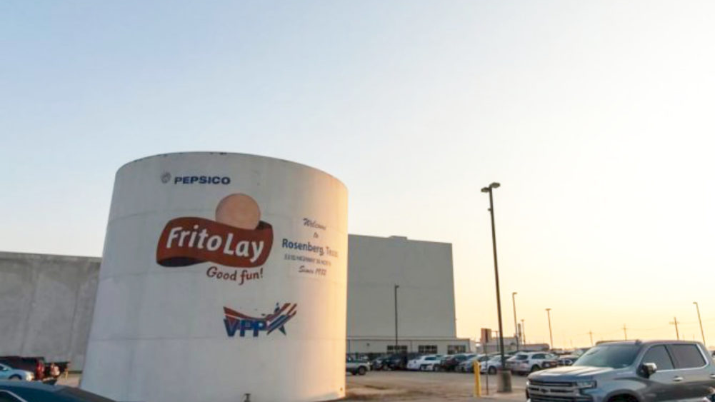
Addressing & Preventing Attrition at Frito-Lay
Courtesy of DDSAnalytics (Jack Pehlke)

Slide 2

About us
Helping you develop + retain staff
Data Science and Predictive Analytics
Providing a competitive edge

Slide 3

Attrition
PROBLEM
Culture
Costs
Quality
SOLUTION
Identify
Predict
Implement
?

Slide 4
Identify
Which of these correlated to the highest rates of attrition?
Age
Daily Rate
Distance From Home
Education
Employee Number
Environment Satisfaction
Hourly Rate
Job Involvement
Job Level
Job Satisfaction
Marital Status
Monthly Income
Monthly Rate
Number of Companies Worked
Percent Salary Hike
Performance Rating
Relationship Satisfaction
Stock Option Level
Total Working Years
Training Times Last Year
Work Life Balance
Years At Company
Years In Current Role
Years Since Last Promotion
Years With Current Manager

Slide 5
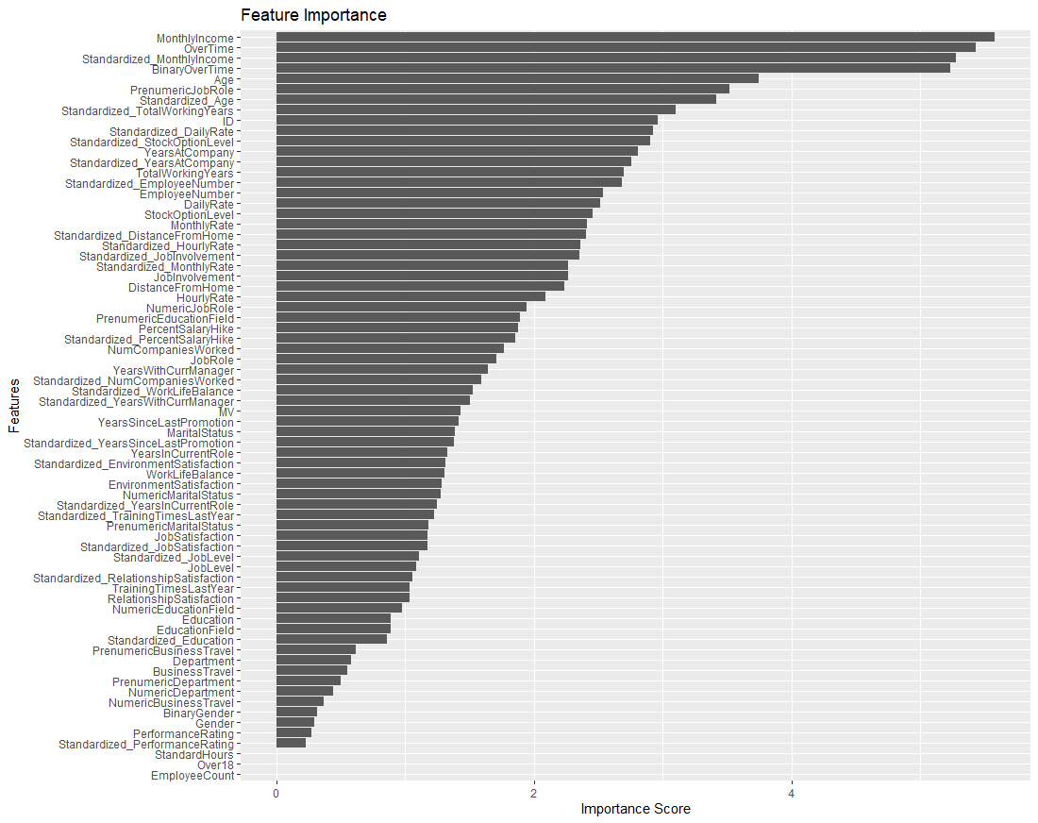
Random Forest & Feature Importance
Monthly Income
Overtime
Age

Slide 6
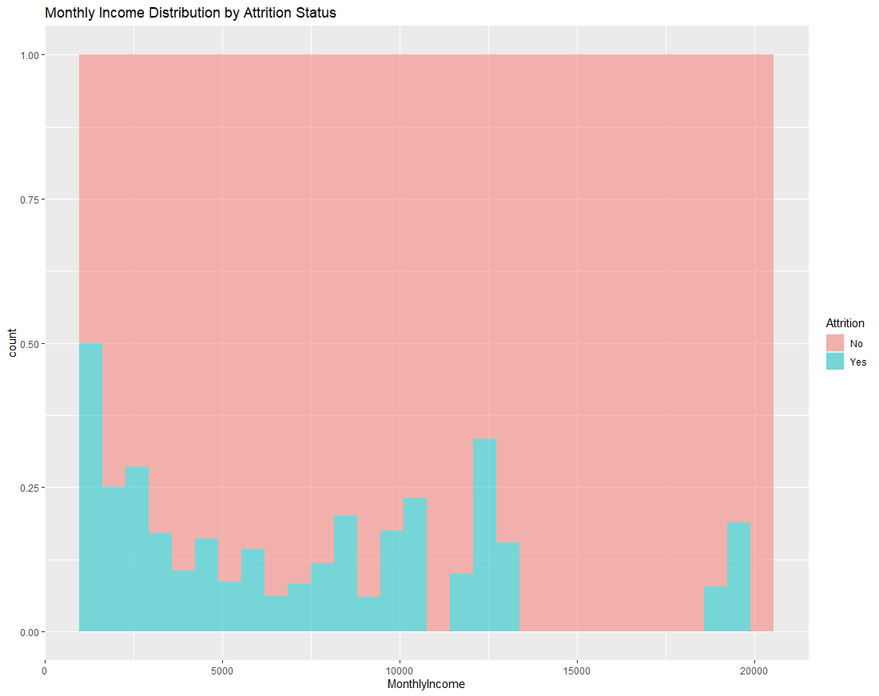
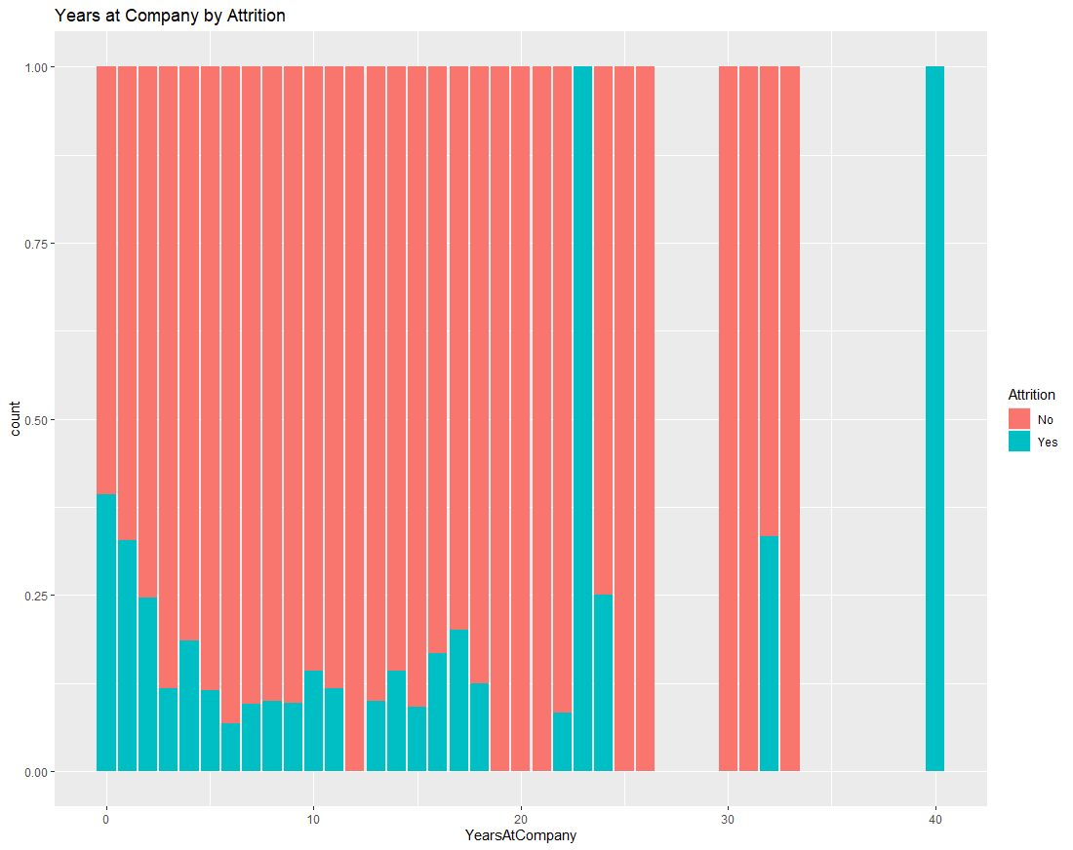
Monthly Income vs. Attrition

Slide 7
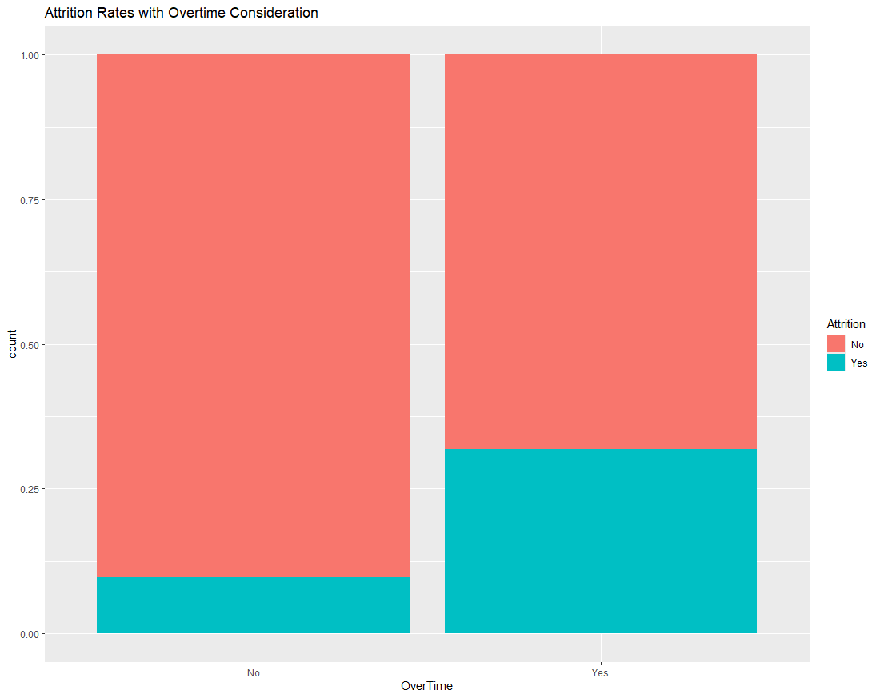
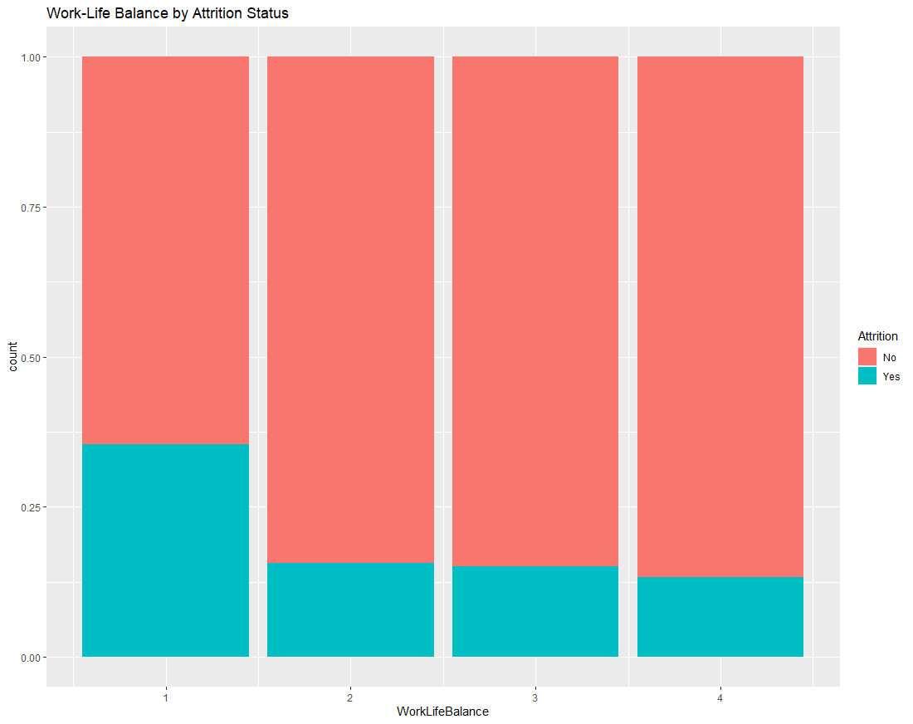
Overtime vs. Attrition

Slide 8
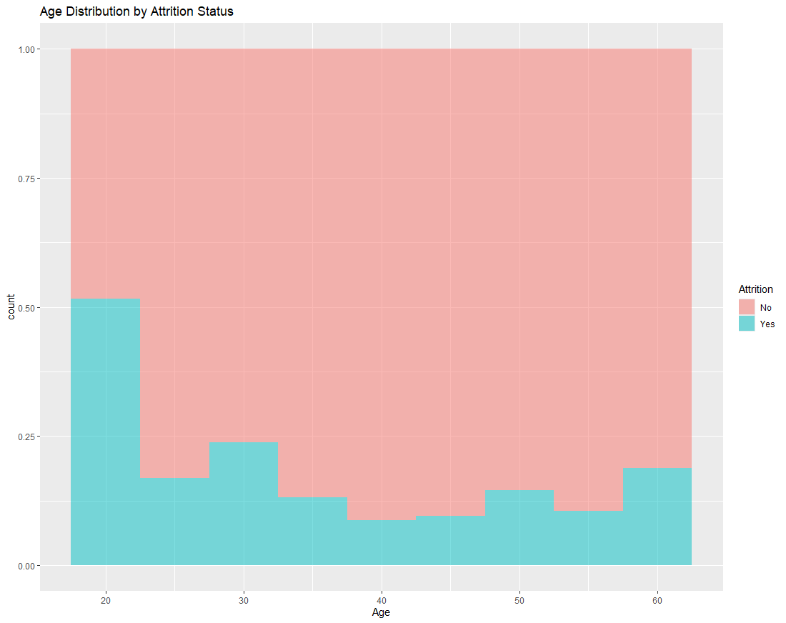
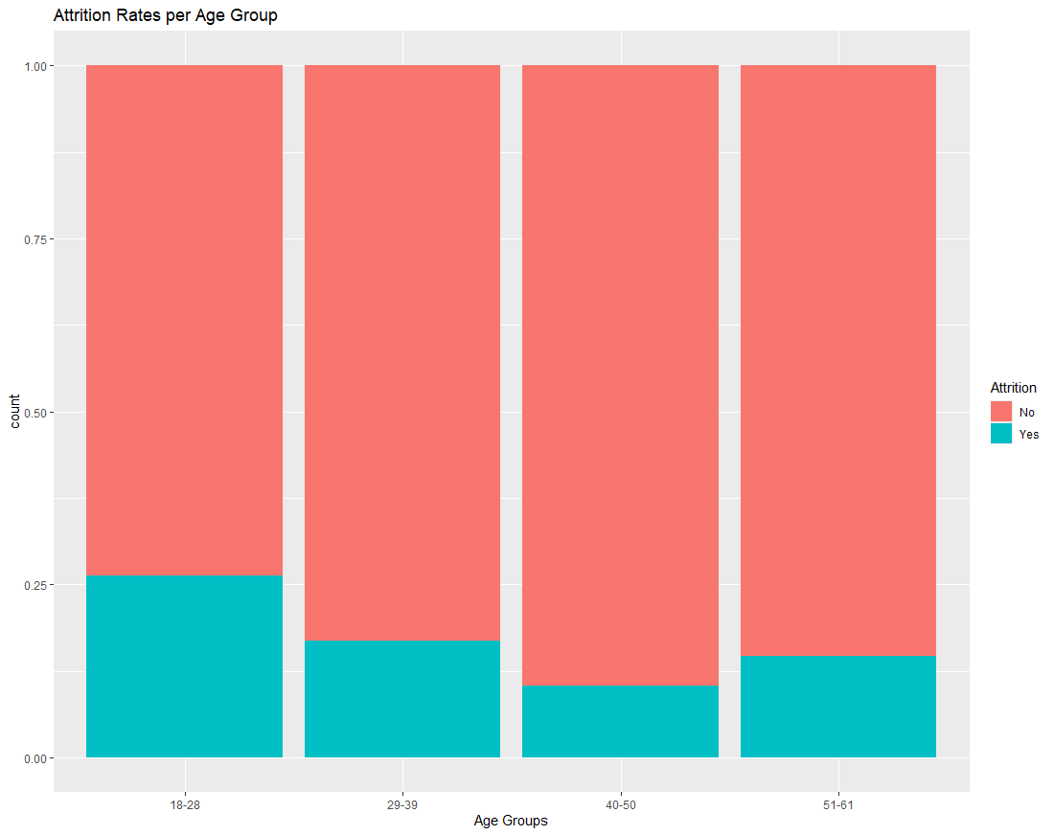
Age vs. Attrition

Slide 9
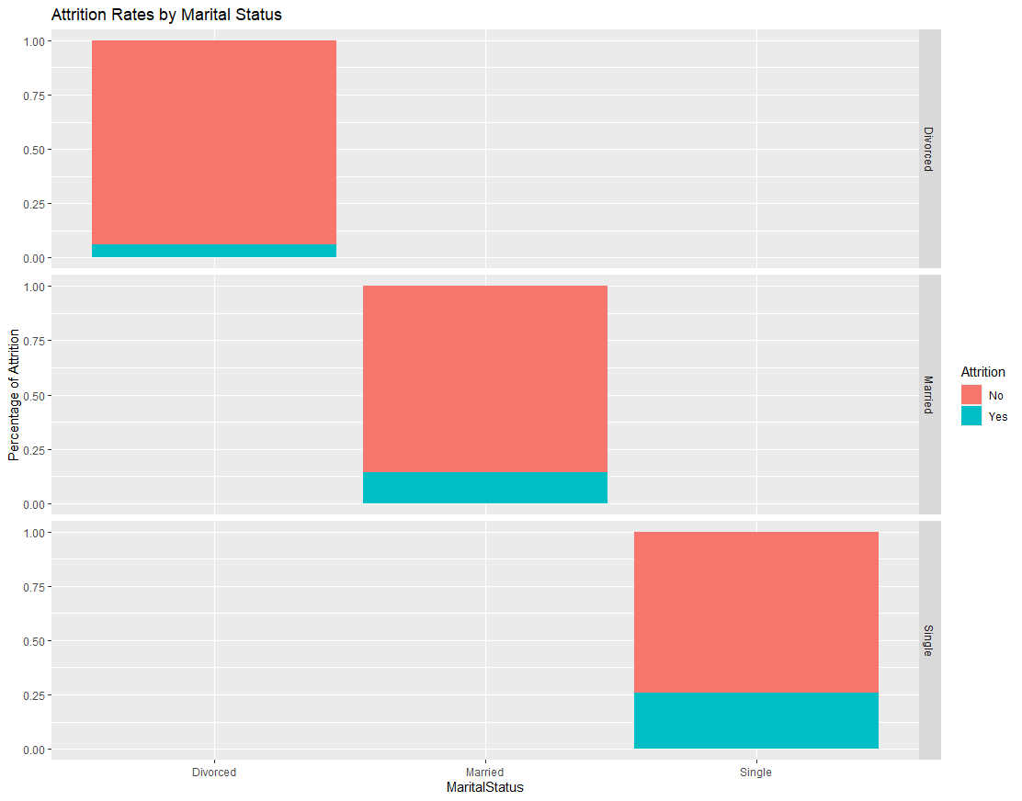
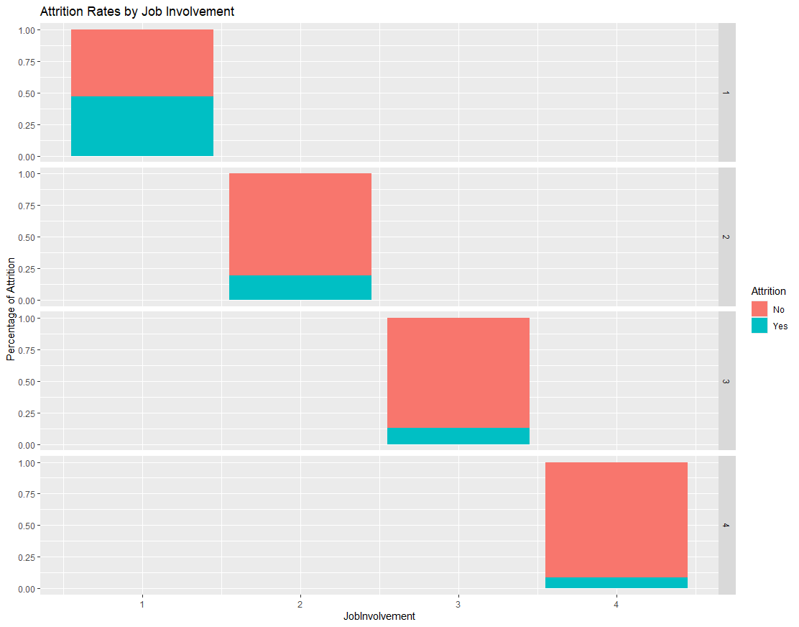
Marital Status + Job Involvement

Slide 10
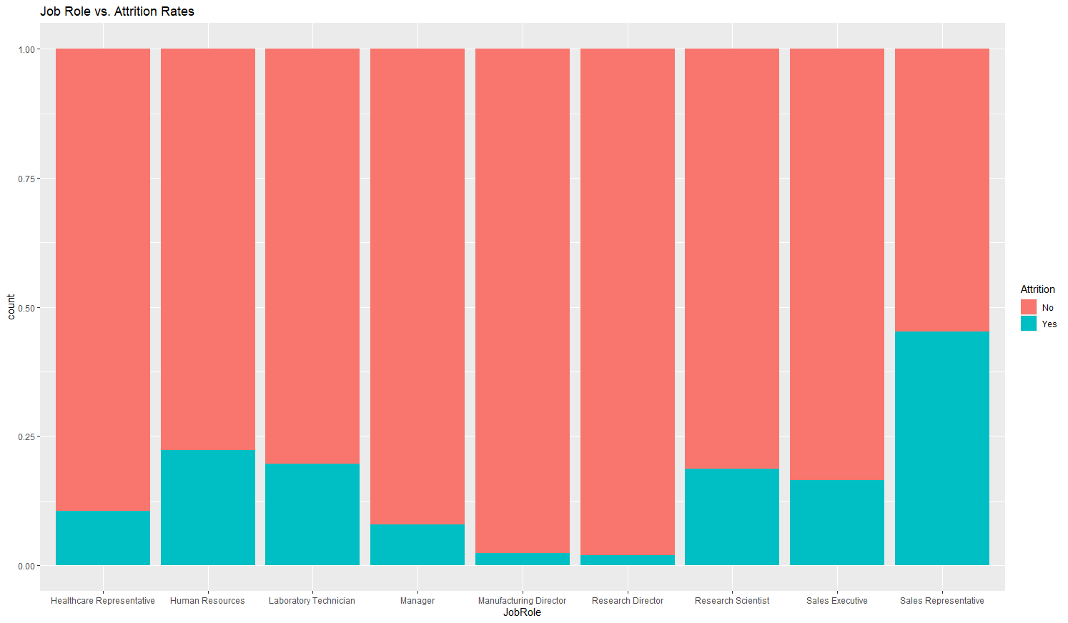
Job Role Trends

Slide 11
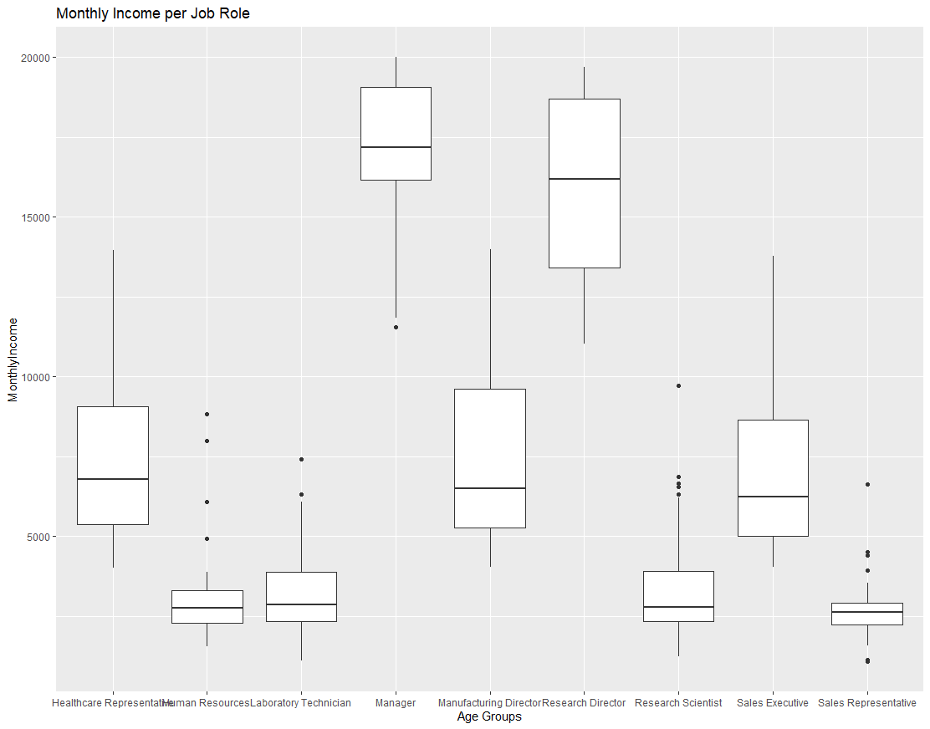
Job Role Trends

Slide 12
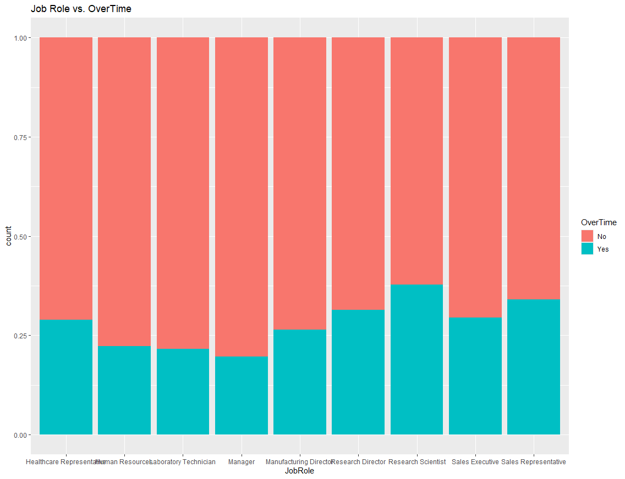
Job Role Trends

Slide 13
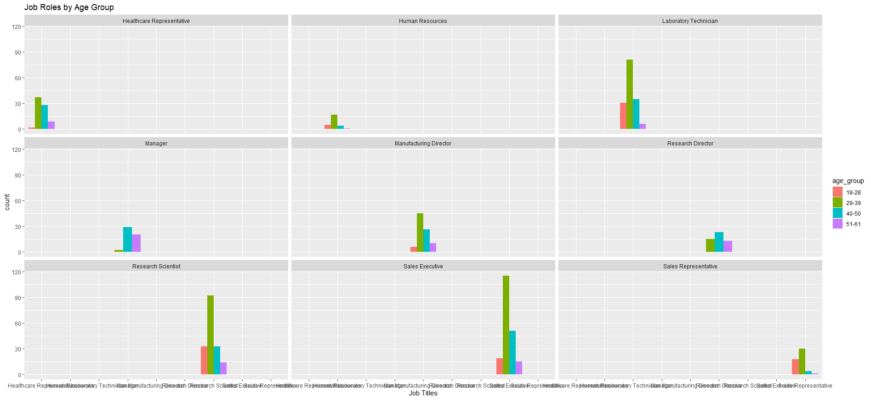
Job Role Trends

Slide 14
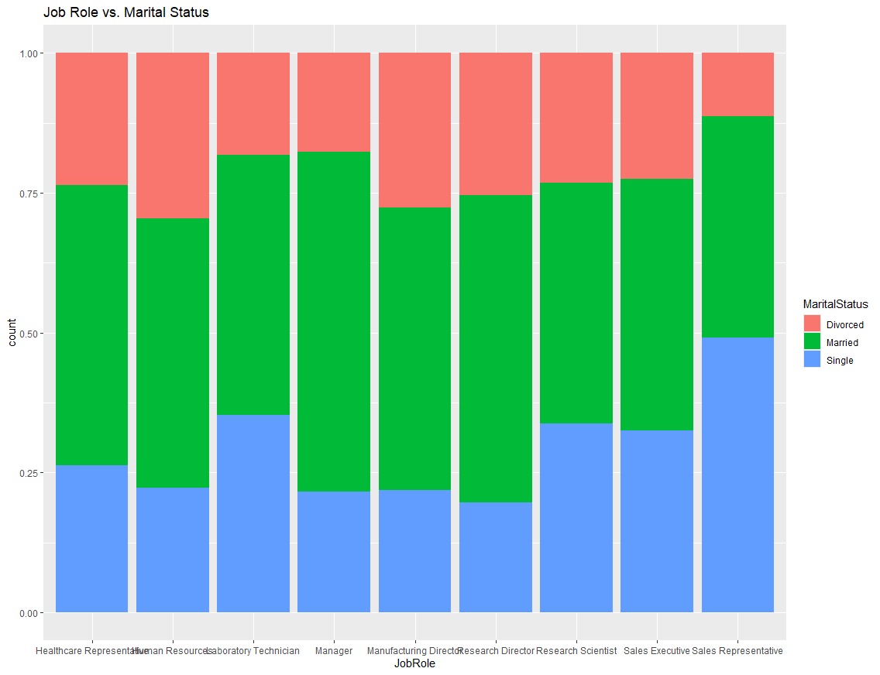
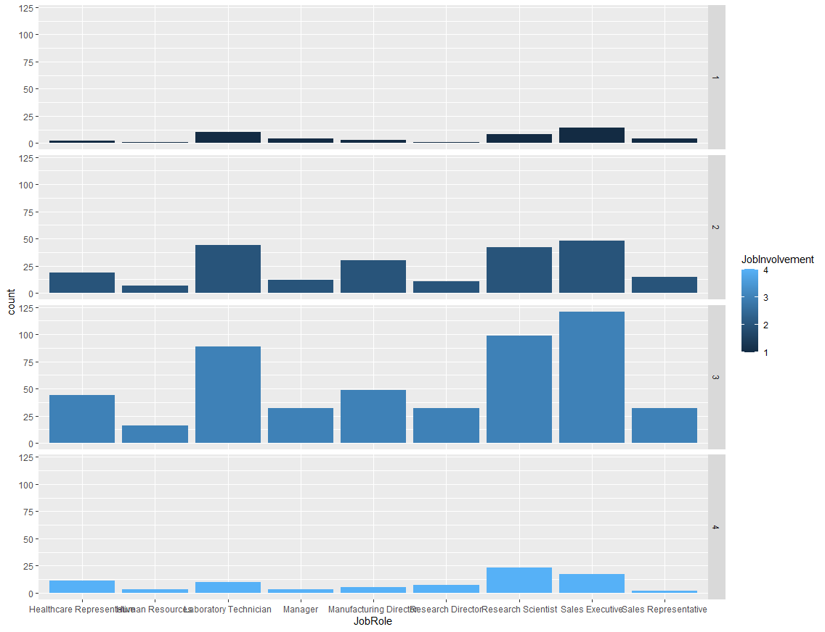
Job Role Trends

Slide 15
Identify
Which of these correlated to the highest rates of attrition?
Age
Daily Rate
Distance From Home
Education
Employee Number
Environment Satisfaction
Hourly Rate
Job Involvement
Job Level
Job Satisfaction
Marital Status
Monthly Income
Monthly Rate
Number of Companies Worked
Overtime
Percent Salary Hike
Performance Rating
Relationship Satisfaction
Stock Option Level
Total Working Years
Training Times Last Year
Work Life Balance
Years At Company
Years In Current Role
Years Since Last Promotion
Years With Current Manager

Slide 16

Naive Bayes Model
Accuracy
83.33%
Sensitivity
87.26%
Specificity
62.86%
Confusion Matrix | Predicted No | Predicted Yes
Actual No | 637 | 52
Actual Yes | 93 | 88
16

Slide 17
Thank You
DDSAnalytics
555-555-0146
dds@DDSA.com
www.ddsa.com

